Slide 1

Sogeti CloudBoost Library

Slide 2
The training program
Part 1 online Why and What - The As Code paradigm.
Part 2 self Online courses.
Part 3 onsite Hands-on Hackathon.
Part 4 online Use, contribute and sell it.

Slide 3
Training Part 1
The why and what The As Code paradigm.

Slide 4
When
Consistency at scale
Maximum Cloud benefits
Enterprise DevOps challenges

Slide 5

What slows your team down?
Stop trying to turn all your developers into DevOps pros, rather speed up on business functionality…
Notes:
James Staten Chief Strategist, Cloud + Enterprise, IaaS isn’t your only path to outsized gains

Slide 6

Cloud Adoption
Migrate to the Cloud
Cloud Native Systems
Rehost
(lift- shift)
Refactor
(redeploy)
Revise
(devops)
Rebuild
(devops)
New
(devops)
Cloud benefits
Cloud benefits
Time
Cloud benefits
Cloud benefits
Cloud benefits

Slide 7
CloudBoost Library
Migrate to the Cloud
Cloud Native Systems
Rehost
(lift- shift)
Refactor
(redeploy)
Revise
(devops)
Rebuild
(devops)
New
(devops)
Enterprise readiness
Cloud benefits
Cloud benefits
Less time
Time
Cloud benefits
CloudBoost Library
Cloud benefits
Cloud benefits

Slide 8
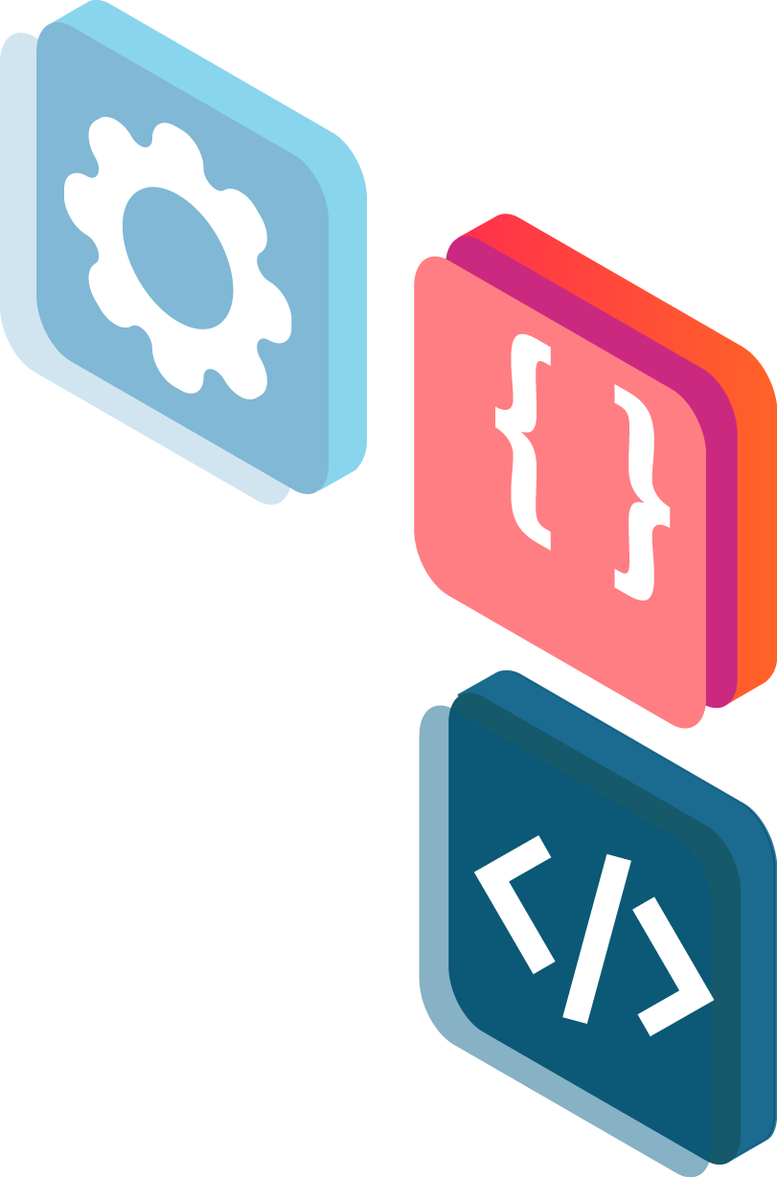
Sogeti CloudBoost Library
What is in the GIT repo and what can you do with it.
1
2
3
4
Infra as Code, written in ARM and Terraform written for the most Cloud resources of Azure and AWS
Config as Code, for Windows and Linux OS in PowerShell DSC and Ansible for most machine configurations.
Pipelines as Code to provision Cloud infrastructures on Azure and AWS for Azure Pipelines, GitLab and Jenkins
Practices, Way of Working, Checklist and guidelines to maximize the benefits and work with Cloud.

Slide 9
As Code paradigm
The ‘as code’ paradigm is about being able to reproduce and/or restore a full environment within minutes based on recipes and automation, managed as code.
https://martinfowler.com/bliki/InfrastructureAsCode.html

Slide 10
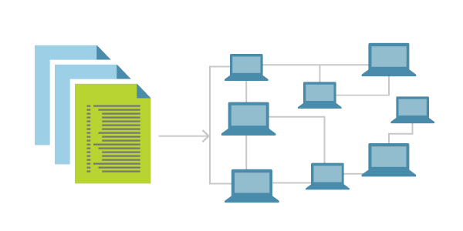
IaC is a key DevOps practice
Infrastructure as Code is the management of infrastructure (networks, virtual machines, load balancers, and connection topology) in a descriptive model, using the same versioning as DevOps team uses for source code. Like the principle that the same source code generates the same binary, an IaC model generates the same environment every time it is applied. IaC is a key DevOps practice and is used in conjunction with continuous delivery.
https://docs.microsoft.com/nl-nl/azure/devops/learn/what-is-infrastructure-as-code

Slide 12

Sogeti CloudBoost Library
Library
Landing zone
Reusable and maintained library of Cloud resources, scripts, packages and pipelines.
Conform Sogeti reference architecture, principles, guidelines and practices.
Holds Cloud capabilities which are automatically provisioned in a fast, flexible, compliant, reusable and comfortable way.
Preconfigured base with Cloud resources for security, compliancy and all other no functionals.
Automatic provisioned out of release pipelines by using the service catalog
A best practice platform conform industry standards and regulator rules.

Slide 13
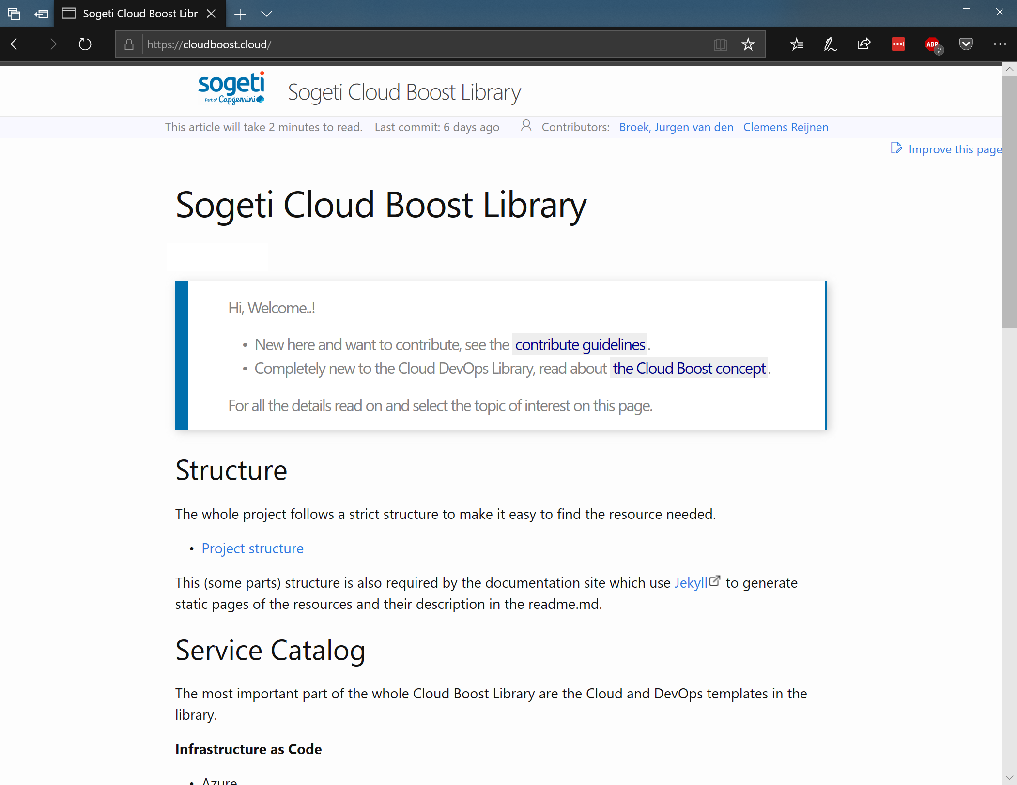
Docs
CloudBoost.Cloud
Us.CloudBoost.Cloud
Generated from markdown everyday based on the documentation next to the –as code- templates.

Slide 14
Browse the site
Contribute to the documentation.
Contributors are recognized.
Last time a contribution has be committed.
Contribution guidelines and environment setup.

Slide 15
OneDeliver CloudBoost Library
Reusable Cloud resources designed with DevOps in mind, conform industry standards and practices.
1
2
3
4
5
Validated automatic within pipelines.
Maintained on Cloud provider capabilities and practices.
Supported on Usages and setup.
Developed Sogeti Open Source.
Controlled by Sogeti review board and validated with Cloud provider.

Slide 16

Open Source Development
CloudBoost.VisualStudio.com
+20.000(0)
Sogeti colleagues can contribute on Azure Repos.

Slide 17



Work with the CloudBoost Library
CUSTOMIZATION
NO
YES
1.1
1.2
YES
GIT Submodule
Own GIT branch
CONNECTED
2.1
2.2
NO
Own library
Package manager

Slide 18

Sogeti CloudBoost Library
Re-use
Standardize
Best Practices
Reference Architecture
Efficiency
Knowledge sharing
Compliance
Governance
DevOps
Optimize innovation

Slide 19
Needed knowledge
Cloud services
What can you make with Cloud, what are the avaialble Cloud resources and what are the configuration options.
Cloud template language
How to script the creation of cloud resources.
Git versioning
Control the creation and colloboration of team work
Azure DevOps pipelines
Automate

Slide 20
Homework
Oneline courses to follow
Azure Resource Manager DevOps Jump Start. (must have knowledge)
Resources to learn Git. (must have knowledge)
Automating Azure Workloads (must have knowledge)
Continuous Integration and Continuous Deployment (must have knowledge)
DevOps Practices and Principles (optional)
Azure Repos Git tutorial (optional)
Decide on the Cloud Infra to create during hackaton
… share diagram within a week, this give us time to look.
You wil get a link and access to Azure DevOps and an Azure resource group, try if this access works before the workshop.
Get your development environment ready: https://cloudboost.cloud/docs/DevSetup/

